Slide 1

IDEA SUBMISSION

Slide 2
Idea Submission
Team Details
Team name: The OG Coders
Team leader name: Kadali Chaitanya Naga Satya Charan
Team members names: 1. KALLEPALLI SAI VENKAT 2. KOLLI RAM SAI
3. Vatturi D G S R S Manikanta
Problem Statement: Scaling Trust: AI-Powered Detection of Online Harms

Slide 3
Brief about the Idea
Our project focuses on building an AI-powered platform to address the escalating issue of online harms.
The solution leverages machine learning, NLP, generative AI to detect, moderate, and prevent harmful content .
By combining automated content filtering, real-time group chat moderation, multilingual support, and user reporting mechanisms, we aim to create a safer inclusive online community.
Live link - https://safecyber.vercel.app/

Slide 4
How different is it from any of the other existing ideas?
Real-Time Moderation: Unlike traditional tools, our platform integrates advanced google AI models to provide immediate moderation for textual, image, and video content in real-time.
Comprehensive Feature Set: Features such as humor detection to differentiate between unintentional harm, a group chat system with dynamic tagging, and complaint submission portals make this platform unique.
User-Centric Approach: We empower users through self-reporting options and complaint mechanisms while ensuring transparency with a metrics dashboard.
Integration with Advanced Tools: The platform incorporates multilingual NLP libraries, OpenCV and YOLO for visual content filtering, and Gemini APIs for misinformation validation.

Slide 5
How will it be able to solve the problem?
Automated Detection: AI models detect and flag harmful content, reducing the workload on human moderators.
Real-Time Mitigation: Content filtering for group chats and post submissions ensures harmful content is addressed before it reaches users.
Misinformation Identification: Leveraging APIs and trueness scoring systems to verify sources and provide context around content.
User Empowerment: Reporting tools and direct complaint mechanisms encourage users to participate in moderation, fostering a collaborative environment.
Adaptability: Multilingual support and AI-driven humor detection make the platform versatile across different demographics and contexts.

Slide 6
USP of the proposed solution
Real-Time Moderation Across Content Types: Text, image, and video filtering with immediate action.
Advanced Misinformation Validation: Integration with Gemini APIs for accurate trueness scoring and tagging.
Bully-free Group chats: The messages by the users in group will be tracked in real time for any cyberbully content and blocks the harmful content.
Impact Transparency: A metrics dashboard showcasing moderation statistics and platform impact.
Scalability: Multilingual NLP support ensures global accessibility.

Slide 7
List of features offered by the solution
Automated Content Filtering: 1. Replace bad words with ‘***’ or block data.
2. Block vulgar images/videos using OpenCV and YOLO.
Group Chat Moderation: 1.Tagging of messages for misinfo and bad words.
2. User-driven reporting of harmful content.
Misinformation Verification: 1. Trueness scoring (0-100%) for news verification.
2. API-driven source tagging and categorization.
Complaint Portal: Direct user complaints to cybercrime authorities via email integration.
User Reporting and Blocking: Ban users for repeated offenses (e.g., 5 incidents of cyberbullying).
Humour Detection: Ask for user explanations to differentiate jokes from harmful intent.
Trending Fake News Page: Highlight currently trending misinformation topics for awareness.
Impact Metrics Dashboard: Showcase moderation statistics and user participation metrics.
AI Chatbot for Cyberbullying Assistance: Guide users on handling cyberbullying situations.

Slide 8
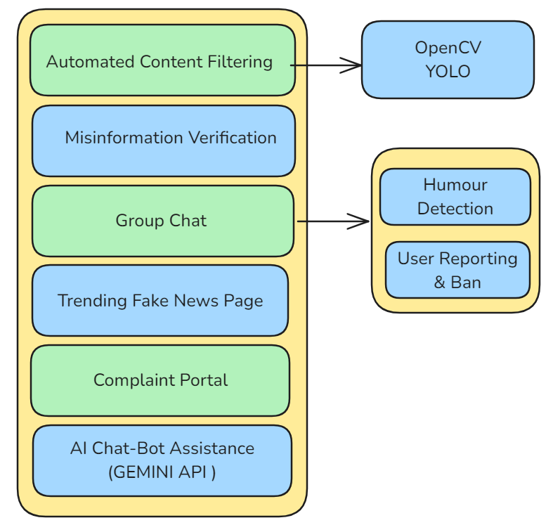
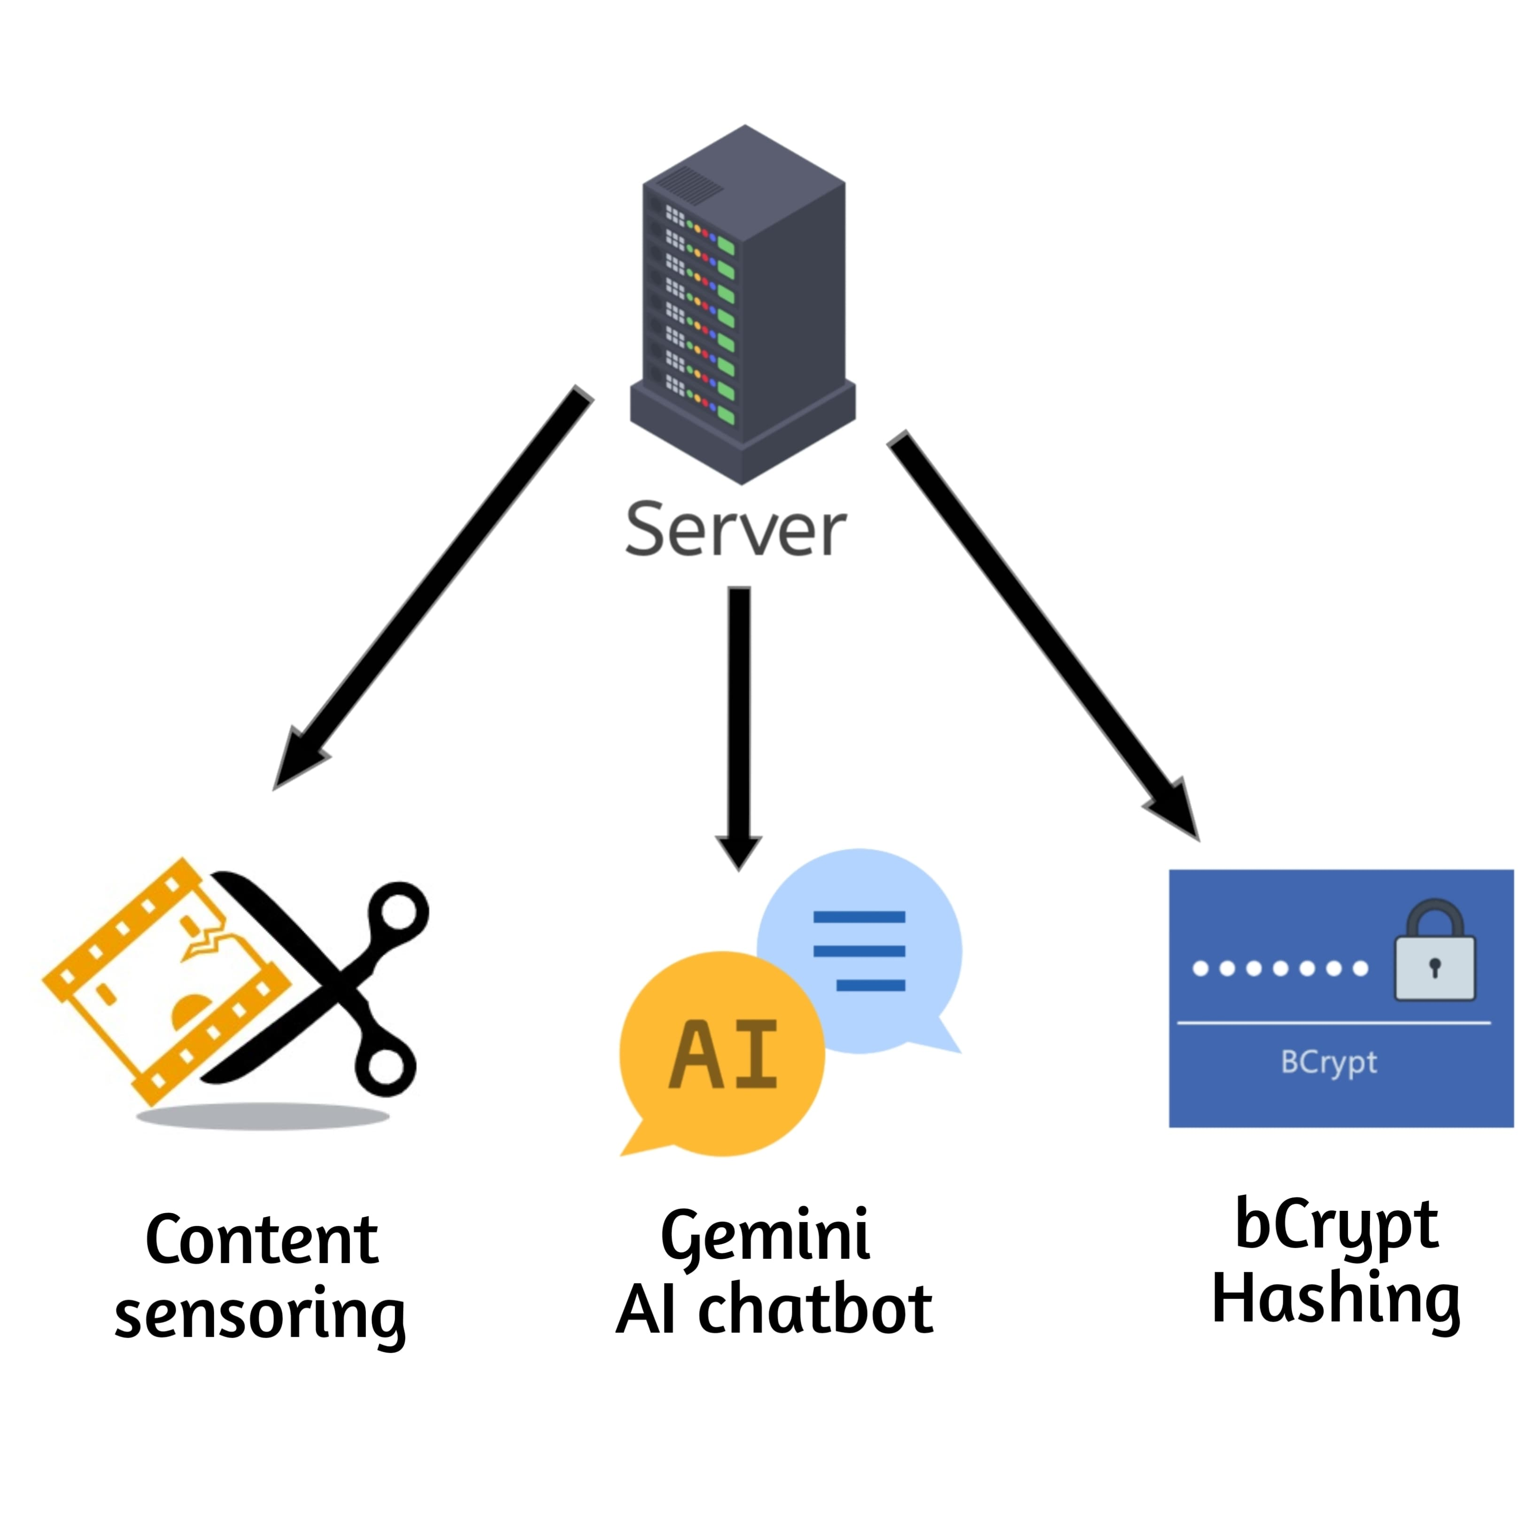
Process flow diagram or Use-case diagram

Slide 9
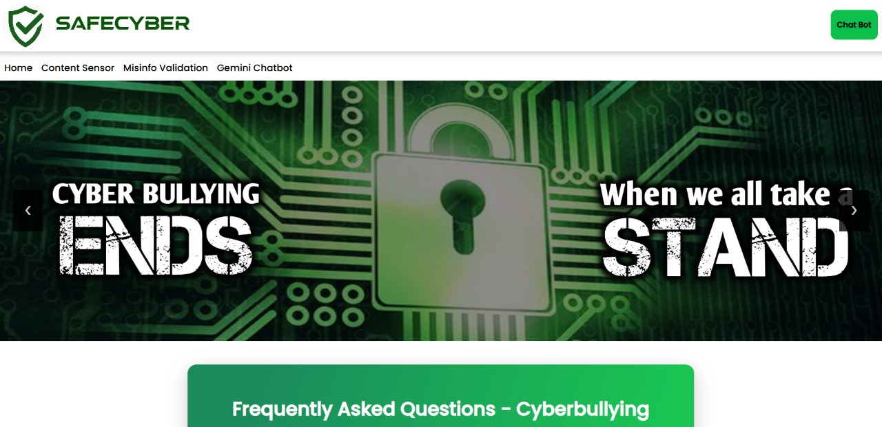
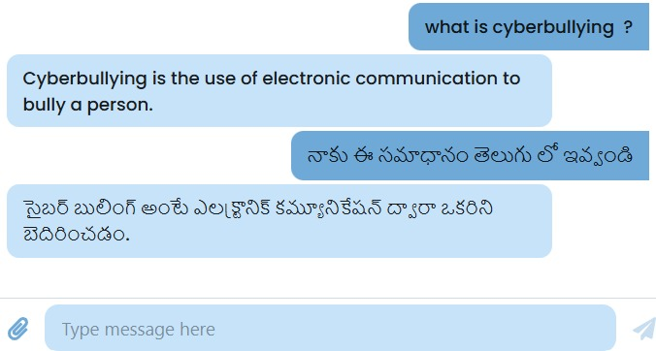
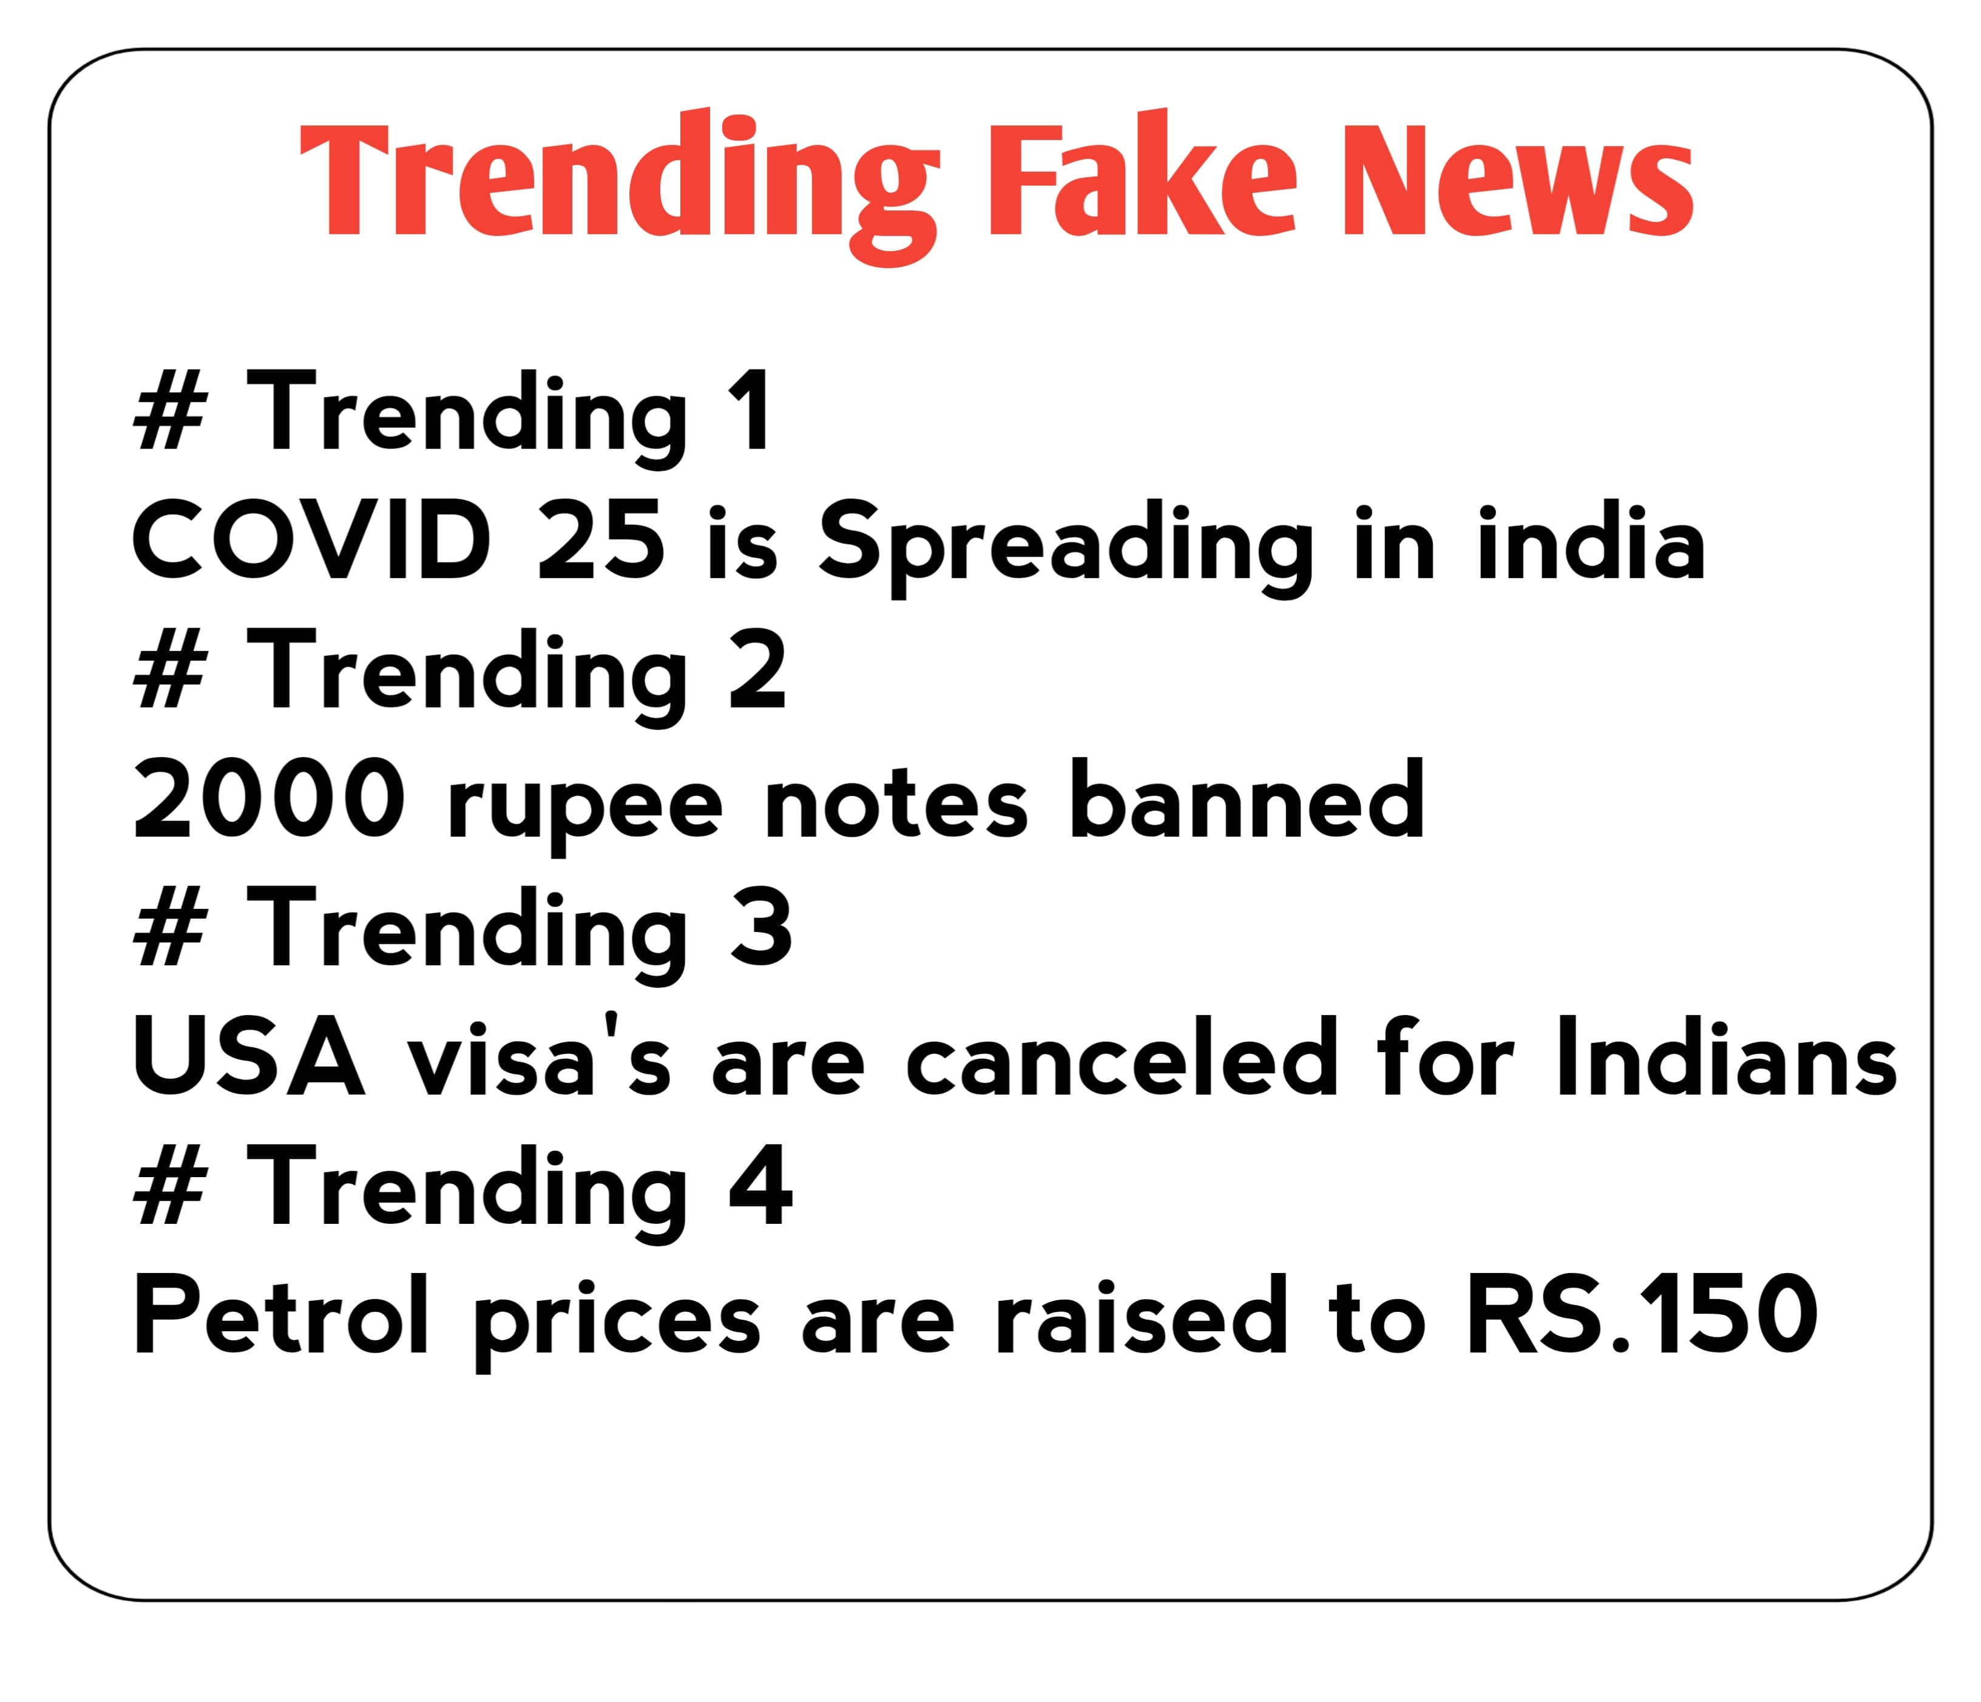
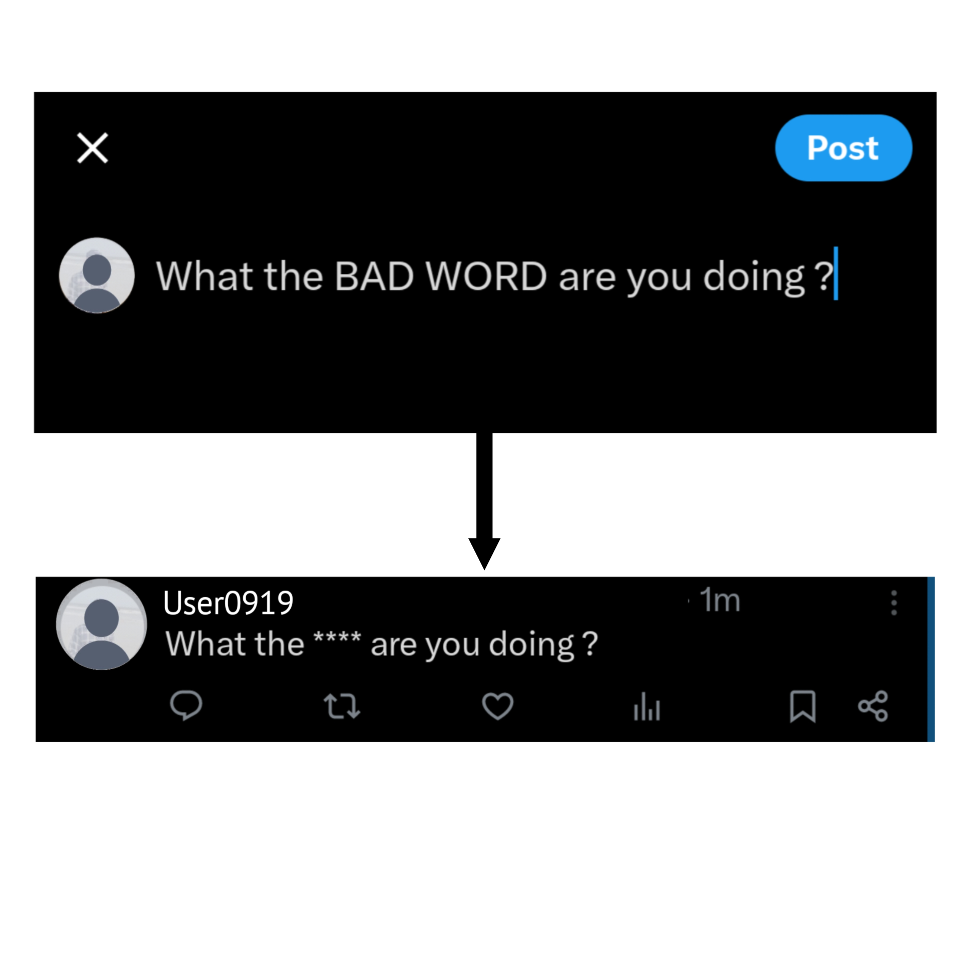
Wireframes/Mock diagrams of the proposed solution

Slide 10

Technologies that are being used/planning use during prototype
development
(Additional points for those who are:
Building their project on IDX
Integrating Gemini APIs)
NLP for Text Analysis: Multilingual NLP using Hugging Face Transformers.
Image and Video Analysis: OpenCV and YOLO for detecting and filtering explicit content.
Misinformation Detection: Google Gemini API for trueness scoring and source verification.
Backend : Node.js and Express for server-side functionality.
Frontend: React.js and Tailwind CSS for responsive and dynamic interfaces.
Database: MongoDB for storing user data, flagged content, and complaint records.
Websockets : we use websockets for real-time group chat among users in the group

